Slide 1
Sherwin-Williams
GBSC 2026
Round 1 Training

Slide 2
Content
Introduction
Key Links For More Information
Target Customers
Key Problems/Pain Points
Visual aids
Final tips & takeaways

Slide 3
What Sherwin-Williams Offers
Sherwin-Williams is primarily a coatings company, and its offerings fall into two broad buckets:
coating products (paint and related materials)
support services for homeowners, contractors, and industrial customers.

Slide 4
Suggested Links For Review
https://www.sherwin-williams.com/
Sherwin-Williams - YouTube
https://www.sherwin-williams.com/property-facility-managers
https://www.sherwin-williams.com/property-facility-managers/products/resources
https://www.sherwin-williams.com/painting-contractors/pro-plus

Slide 5
What Sherwin-Williams Does
They personalize our communication
  Customers feel like they are valued and that we understand them
They offer solutions that provide value to the customer and their business
  Provide a Sherwin-Williams Customer Experience

Slide 6
Round 1 Is Discovery
Meeting preparation suggestions

Slide 7
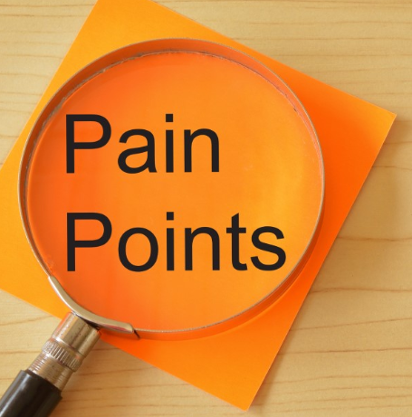
Steps
Introduce yourselves
Discover the prospect pain points
Propose a path forward
Secure a next meeting
Adjourn
You have 15 minutes
Check the rubric

Slide 8
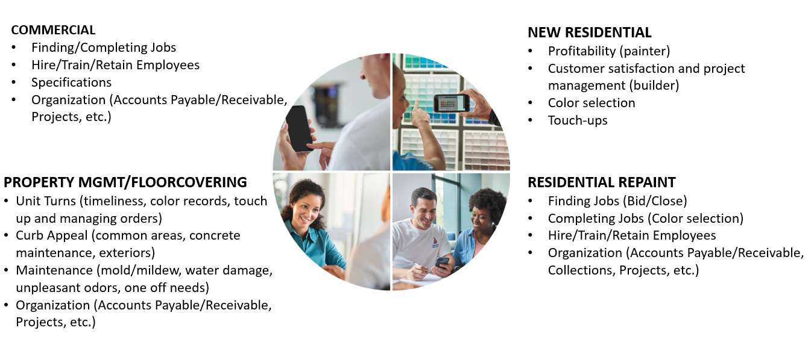
Potential Pain Points

Slide 9

  ASK SITUATION Questions
    What are some issues you are encountering?
    What’s slowing you down?
    What’s keeping you up at night?
  SHUT UP AND LISTEN
  PROMPT FOR PROBLEMS YOU CAN RESOLVE
    Tell me more about the problem?
    How is that slowing you down/keeping you up?
    What happens if you don’t solve the problem?
    What happens if you do?
  PROVIDE INFORMATION (TOOL/PEOPLE/RESOURCE) AND ASK A QUESTION
    How would/does that tool help you?
    How will that help make your life easier?
Notes:
Discuss the points on the slide and how they related back to what we just talked about.
Spend a minute on the concept of “listening to understand rather than respond”. This is key to being a better sales person. You don’t prescribe a solution w/o understanding what it is that your customer wants/needs.

Slide 11
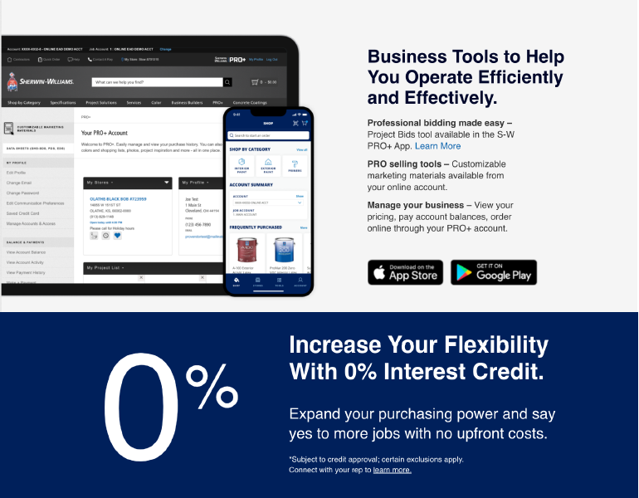

Slide 13
Thank you

